Slide 1
Trusts Law
Week 15: Tracing (I)
Dr Johanna Jacques

Slide 2
Tutorial 3
Public benefit:
  Distinguish between legal requirements and a critical assessment of the charitable status accorded to various purposes of arguable public benefit.
  Remember that charitable status effectively means subsidies from the public purpose.
Three types of trust:
  Beneficiary;
  Purpose;
  Something in-between, usually resolved for one or the other.
Personal nexus:
  A link between those who will benefit from the purpose and one legal or natural person.
  That person is not necessarily the settlor.

Slide 3
Our progress so far
You have already learned about:
Trustees’ duties as fiduciaries.
Remedies for breaches of fiduciary duties.
Trustees’ trust duties.
Remedies for breaches of trust duties.
This week and next:
Proprietary remedies, or, how to recover the property itself or its substitution, particularly where the trustee no longer has it.

Slide 4
This week, our aim will be:
To understand the advantages of proprietary claims
To understand and distinguish the concepts of following, tracing, claiming and remedy
To understand and be able to apply the different steps involved in a proprietary claim

Slide 5
Proprietary claims
Last week: personal liability of trustee
This week: proprietary claim
Transfers P in breach to
Trustee
C
Commits breach
= loss to trust fund
Trust
Property
Traces P to
Beneficiary

Slide 6
Advantages of proprietary claims
No wrongdoing by recipient required
Higher chances of success
Recovery of specific property
Priority on insolvency
Increase in value can be recovered

Slide 7
The structure of a proprietary claim
Proprietary base
Following or Tracing
Claiming and remedy
Defences

Slide 8

Proprietary base
The claimant, in order to trace, needs to have one of these proprietary rights just before the unauthorised substitution is made:
At common law: the legal title
In equity: a beneficial interest

Slide 9
Following or Tracing
Following and tracing are ‘exercises in locating assets which are or may be taken to represent an asset belonging to the plaintiffs and to which they assert ownership’ (Smith, The Law of Tracing).
They are processes that generate evidence for a claim, they do not establish a claim.
Following identifies the misappropriated property in a party’s hands, while tracing identifies substitute property.
Which process to adopt is usually dictated by the particular circumstances (i.e., does the original property still exist and if yes, will it be likely to be recoverable?)
Even if there are a number of options (due to ‘geometric multiplication’), the claimant must chose one and cannot recover twice.
There are different tracing rules at common law and in equity.

Slide 10
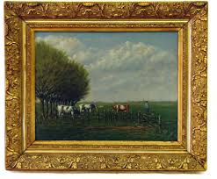

Following
Misappropriated trust property
A
B
Following identifies the same asset as it passes from one person to another.

Slide 11

Tracing
Misappropriated trust property
A
B
C
Tracing identifies substitute property.

Slide 12
The fiction of ‘persistence’
“[When tracing into an unauthorised substitution,] one is not here concerned with following one’s property. There is a difference between following and tracing. One is concerned with the creation of new proprietary rights over property that does not already belong to the claimant but is rather a substitution of property previously owned in equity by the claimant. So, in an unauthorised substitution case, if one is entitled to trace from a pig to a horse to a car, one cannot say, without invoking fiction, that one has proprietary rights in the car merely because one owned the pig that is now represented b the car. The truth is that one’s proprietary rights in the pig entitle one to new property rights in the car because the holder of the car has been unjustly enriched at one’s expense.
Unfortunately, the majority of the House of Lords in Foskett v McKeown . . . has argued that a remedy imposed after tracing is purely a matter of property law and is not concerned to reverse the defendant's unjust enrichment.”
(Andrew Burrows, The Law of Restitution)

Slide 13

Foskett v McKeown [2001] 1 AC 102
Murphy was trustee, holding purchasers’ money on trust with instructions to use the money for a golf course development in the Algarve.
Murphy, in breach of trust, used £20k of the trust money to pay for 2 of 5 payments of his life insurance policy.
Murphy died, leaving £1m death benefit for his children. The purchasers argued they could trace into 40% (£400k) of the death benefit, not only 20k.
Held by 3:2 majority (reversing CA
decision) yes, tracing was possible into
40% of the death benefit.

Slide 14

Claiming and remedies
Once the tracing process has established the location of the relevant property/substitute,
a claim needs to be made.
Different claims are
associated with
different remedies.

Slide 15

Common law claims and remedies
Common law claims include:
  Action for wrongful interference (conversion).
  Action for money had and received.
Note the nemo dat rule (nemo dat non quod habet), which does not apply to money.
Remedies are often (but not always) personal (e.g., compensatory, restitutionary).

Slide 16
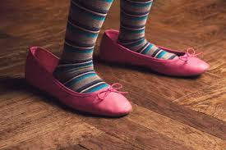
Equitable claims and remedies
Equitable claims are usually the claims of beneficiaries under a trust. Remedies are proprietary and include:
The property or a proportionate share thereof
A lien: An equitable charge
over the property as a
security for the repayment
of the misappropriated value
Subrogation

Slide 17
Property or proportionate share thereof
Transfers £100 in breach to
Trustee
C
Purchases for £200
Property
Trust
Property
Beneficiary
Can recover 50% of the current value of the property

Slide 18
Lien
Transfers £100 in breach to
Trustee
C
Purchases for £200
Property
Trust
Property
Beneficiary
Can recover £100 from the sale of the property

Slide 19
Subrogation: Boscawen v Bajwa [1996] 1 WLR 328
Transfer money to
H (Halifax)
Transfer money to
Solicitors acting for AN and purchasers
Solicitors acting for vendor
Existing
mortgage
PROPERTY
£105k
Transfers
£140k to
Subrogation
Bajwa (Vendor)
Creditor (Boscawen)
Owns
AN (Abbey National)
Loan to be secured by mortgage
Sale falls through

Slide 20
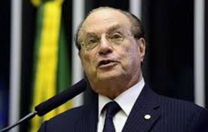
Defences (I)
Dissipation or destruction
  Different consequences at common law and in equity
  Debts and unsecured loans in equity
  Overdrawn accounts and backwards tracing in equity
Federal Republic of Brazil v Durant International Corp [2015] UKPC 35

Slide 21
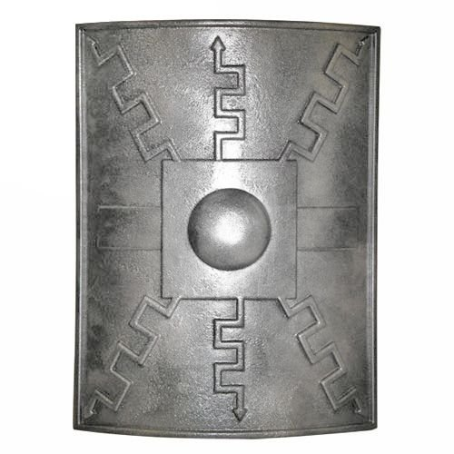
Defences (II)
  Equity’s darling
  Extinguishes title in equity
  Extinguishes title at common law only in relation to negotiable instruments
  Bank deposits
  Change of position/
  inequitability

Slide 22
Recap
Proprietary claims require a proprietary interest in the misappropriated property.
Following and tracing are processes that generate evidence for a proprietary claim.
Claims and remedies differ at common law and in equity.
Respondents have a number of defences by which they can defend a claim.

Slide 23
Activity
A trustee misappropriates £1,000 from a trust fund to which you are the beneficiary. He transfers the money to his wife, who uses it to buy a second-hand car as a birthday gift for their daughter. But the daughter does not pass her driving test and decides to sell the car to her friend for £500 and a sofa she had always liked. The sofa gets damaged during the transport. The daughter pays the £500 into her bank account, which is £200 overdrawn.
Into which property can you trace? (answer on the next page)

Slide 24
Answer
As the beneficiary, you can follow the money from the trustee to his wife. You cannot follow it further to the car dealer, who is equity’s darling. Instead, you can trace the money into its substitute asset, the car in the daughter’s hands, who is a volunteer (she gives no consideration). You cannot trace into the car as it reaches the friend – another bona fide purchaser. You have to trace into the substitute assets, the sofa and the £500. The sofa is destroyed, which leaves only the £500. Payment of a debt constitutes dissipation, so you are left with a bank balance of £300 to trace into.

